Slide 1

Building & Mining Knowledge Graphs
(KEN4256)
Lecture 6: Publishing Knowledge Graphs

Slide 2
© 2024 by Michel Dumontier and the Institute of Data Science at Maastricht University is licensed under Attribution 4.0 International
To view a copy of this license, visit http://creativecommons.org/licenses/by/4.0/
This license requires that reusers give credit to the creator. It allows reusers to distribute, remix, adapt, and build upon the material in any medium or format, even for commercial purposes.
id: KEN4256_L6
version: 1.2024.0
created: January 13, 2019
last modified: March 26, 2024
published on: March 26, 2024

Slide 3
Significant effort is needed to find the right information, make sense of it, understand your rights and responsibilities, and ultimately reuse them for a new purpose

Slide 4
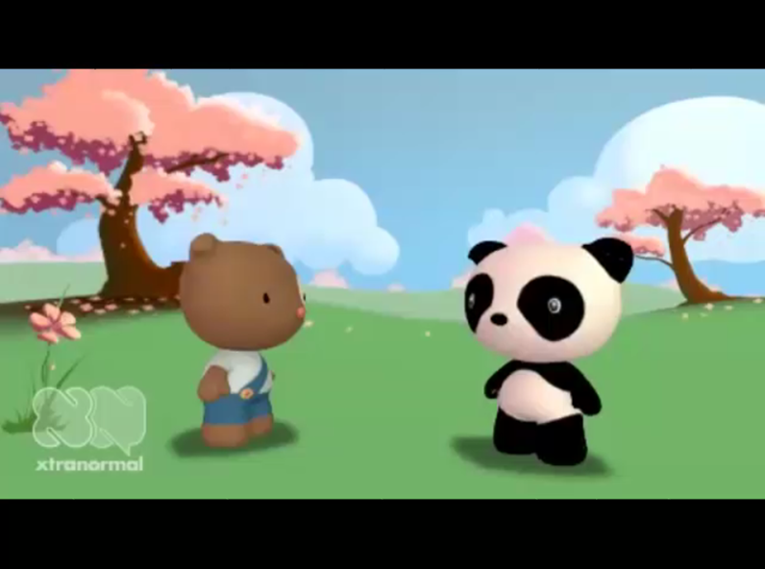
https://youtu.be/N2zK3sAtr-4

Slide 5


What problems were encountered
ⓘ
Click Present with Slido or install our Chrome extension to activate this poll while presenting.
Notes:
📣 This is Slido interaction slide, please don't delete it. ✅ Click on 'Present with Slido' and the poll will launch automatically when you get to this slide.

Slide 6
What problems were there?
Limited data availability
Inefficient data access
Unreliable (non-replicated) storage
Proprietary data format
Non-standardized metadata
No description of the data elements
Lack of contact information
No traceability of data from publication to source

Slide 7
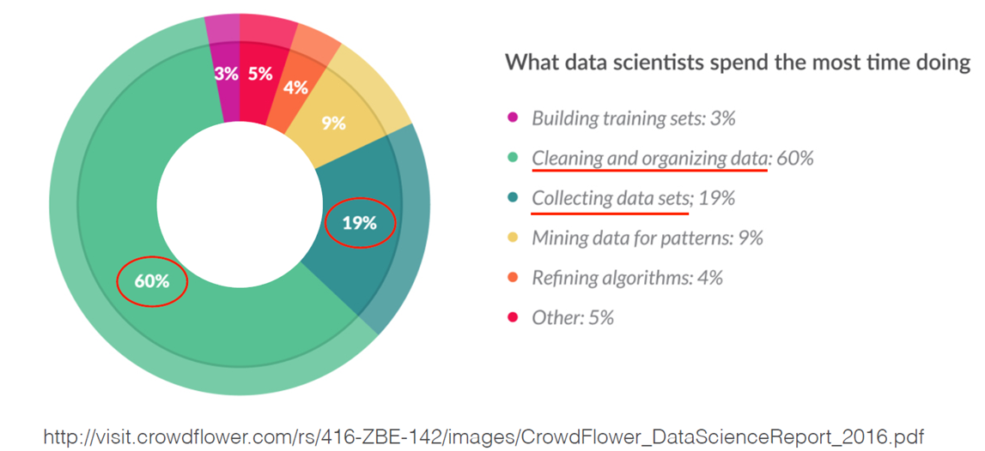

Slide 8
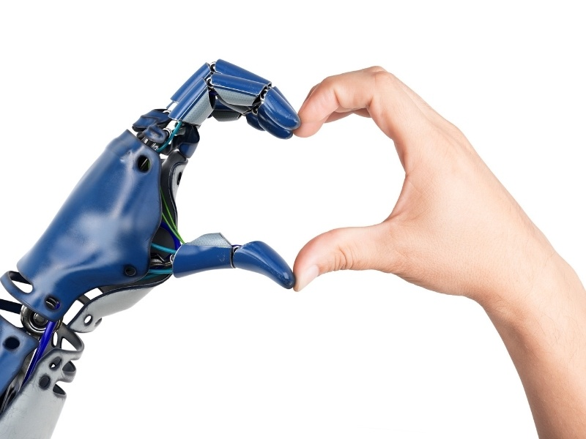
Human Machine collaboration is crucial to our future work

Slide 9
Machines need to be able to discover and reuse data
(and arguably any digital resource)

Slide 10

An international, bottom-up paradigm for the discovery and reuse of digital content
by and for people and machines

Slide 11
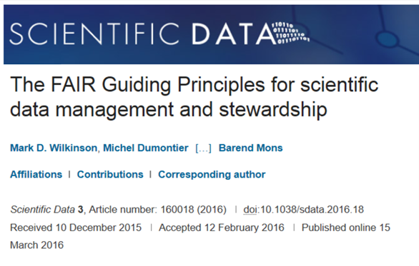



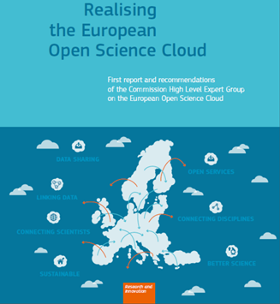
Endorsed by publishers, industry partners, funding agencies
Principles to enhance the value of all digital resources: data, software, repositories, knowledge graphs
http://www.nature.com/articles/sdata201618

Slide 12
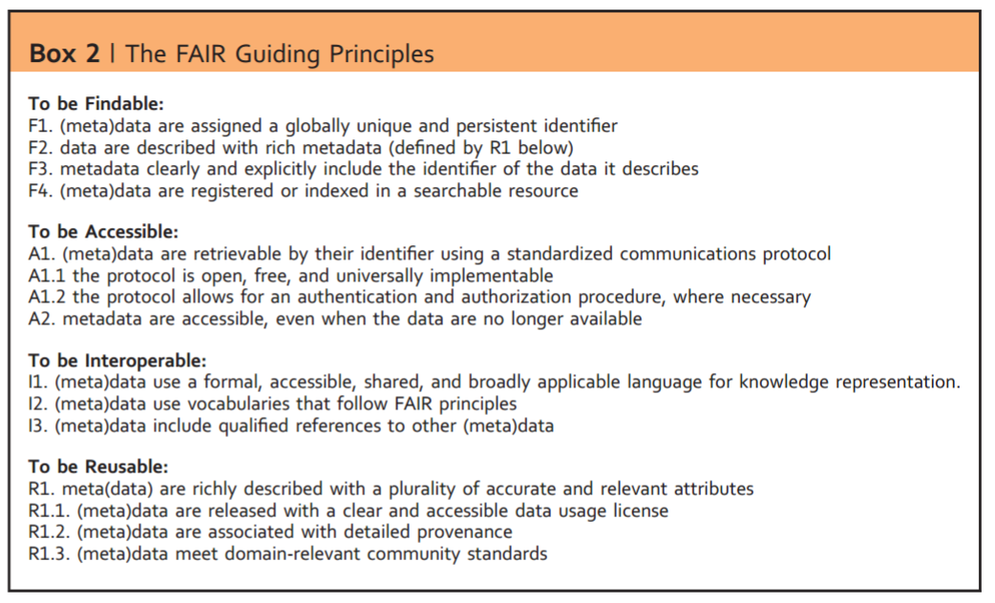
http://www.nature.com/articles/sdata201618
4 facets (F,A,I,R) to the 15 principles.

Slide 13
Making FAIR Data
Collect
Describe
Transform
Publish
Data
Standardized Metadata
Standardized Data
FAIR Data
use standard
metadata format
Use standard
data format
Data Repository
use ontologies + vocabularies
Persistent Metadata Identifier
use ontologies + vocabularies
Standardized Metadata
Persistent Data Identifier
add provenance and license
Standardized Data

Slide 14
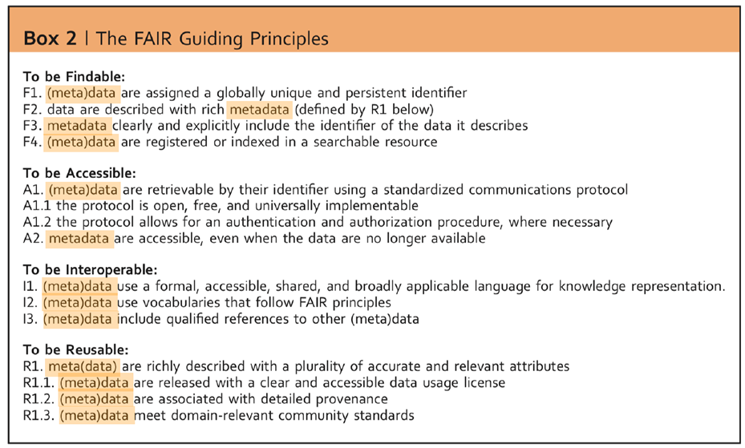
applies to data and their metadata

Slide 15
Data vs Metadata
Data are information made available for machine processing. Data can be quantitative (e.g. height, weight), qualitative (how well do you feel on a scale of 1-5), and multi-modal (text, relational, image, sound, video).
Metadata are information about data. They may contain a description, context, provenance, and meaning of the data.

Slide 16
Metadata
What is the name or title of the digital resource?
What is the digital resource about?
Who contributed to creating or maintaining the digital resource?
When was it created, modified, released?
What methodology or tool was used?
Which language is used?
Which formats is it available as?
What license is it released under?

Slide 17


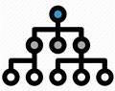
Metadata
Administrative metadata
Provides information about the digital artifact
date created, size of file, type of file
license, permissions, etc
Descriptive metadata
Contains information relevant to find and interpret the data
title, description, keywords
datatype-specific metadata e.g. protocol, instrument
Relational metadata
Captures the relationship between the data item and the entity it is about or is in a contextual relation with
The patient for which the MRI scan was taken

Slide 18
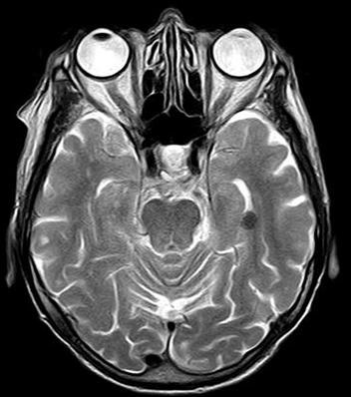

Data and their metadata
Data: jpg image file
Informative metadata:
Size: 155kb
Date created: 2015-05-25
Filetype: jpg
Descriptive metadata
Title: MRI of the head
Device: Ingenia 3.0T
Relational metadata
About: EHR092376573
Clinical Study: CT7812356
Image source: https://pixabay.com/photo-782457/

Slide 19
(meta)data for machines
The long term objective of FAIR is to make content accessible to machines, to support the everyday work we do
Data and their metadata ought to be:
machine readable - the syntax of the data are formally specified to enable reliable reading/writing of the data.
machine interpretable - the semantics of the data elements are well defined and can be reasoned about for information retrieval and query answering

Slide 20

(meta)data for machines
find relevant digital objects that are published on the web
facilitate query and filter content based on specific features of interest.
easier to understand and compare data and their provenance
easier to replicate experiments and reproduce research results
easier to integrate independently produced data
exchange content between different tools and environments
explore and visualize knowledge connections

Slide 21
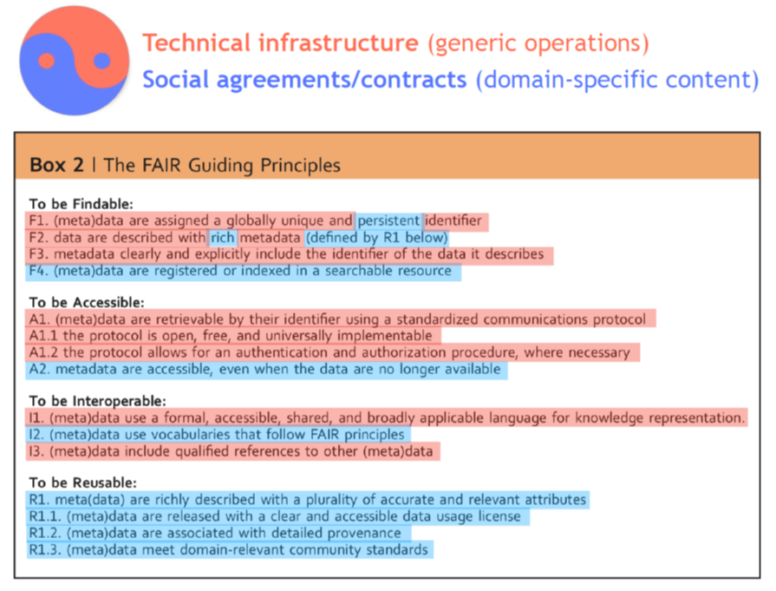

Slide 22
F1: (meta) data are assigned globally unique and persistent identifiers
A unique identifier unambiguously refers a single resource, cannot be confused with another resource, and is never re-assigned to another entity.
An identifier used to denote multiple resources will confound efforts to make describes any one resource, and will lead to confusion when trying to retrieve a corresponding representation.
A persistent identifier is one where there is a technological capability and a corresponding social commitment to ensure continued access to the resource.
for instance, the responsibility to provide the resource can be transferred to another party without having to change the identifier, or there is redundancy in network to provide copies from other providers.

Slide 23
Globally unique and persistent?
26978244
pubmed:26978244
https://pubmed.ncbi.nlm.nih.gov/26978244/
doi:10.1038/sdata.2016.18
https://doi.org/10.1038/sdata.2016.18

Slide 24
Globally unique and persistent identifiers
Obtain globally unique and persistent identifiers from a software or service that uses algorithms that can detect changes in the content.
● Persistent URLs: http://www.purlz.org
● Identifiers.org: http://identifiers.org
● Digital Object Identifier: http://www.doi.org
● Archival Resource Key (ARK): http://n2t.net/e/ark_ids.html
● Global research identifiers: https://www.grid.ac
Globally unique and persistent identifiers owing to content (via digital fingerprint)
● Data GUIDs https://dataguids.org
● Trusty URIs: http://trustyuri.net/

Slide 25
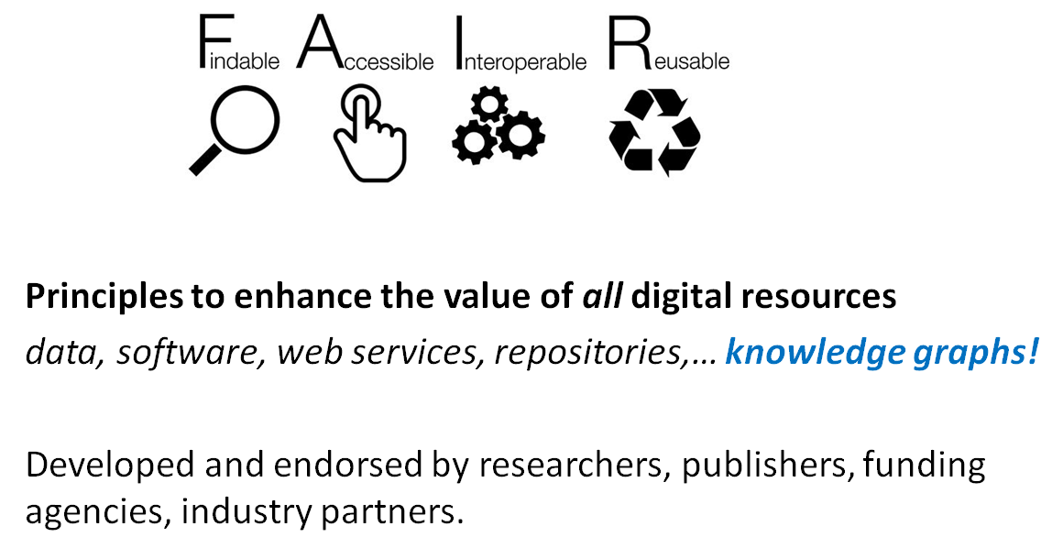

Slide 26
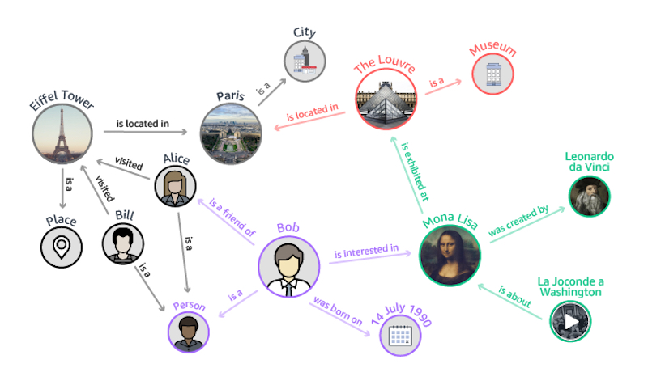

Slide 27

Which metadata could be included to describe a KG?
ⓘ Start presenting to display the poll results on this slide.
Notes:
📣 This is Slido interaction slide, please don't delete it. ✅ Click on 'Present with Slido' and the poll will launch automatically when you get to this slide.

Slide 28
Metadata
What is the name or title of the digital resource?
What is the digital resource about?
Who contributed to creating or maintaining the digital resource?
When was it created, modified, released?
What methodology or tool was used?
Which language is used?
Which formats is it available as?
What license is it released under?
Which descriptive or quality metrics are available?
Who is using it?

Slide 29
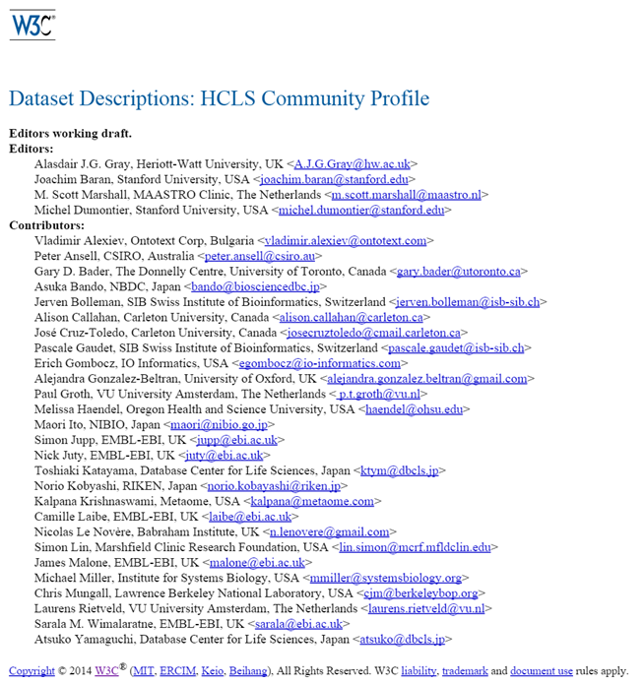
http://www.w3.org/TR/hcls-dataset/
A guide to describing data with RDF vocabularies
Identifiers
Descriptors
Versioning
Attribution
Provenance
Content summarization
Mandatory, recommended, optional descriptors Reference editor and validation

Slide 30
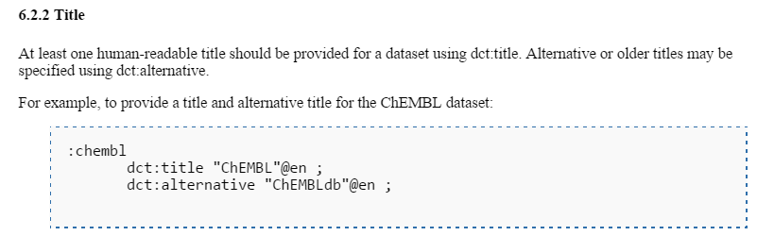
Metadata element, description, and example of use

Slide 31
Basic Description
Identifiers
Title
Description
Homepage
License
Language
Keywords
Concepts and vocabularies used
Standards
Reference Documentation/Publication
Format
Download URL
Landing page
SPARQL endpoint

Slide 32
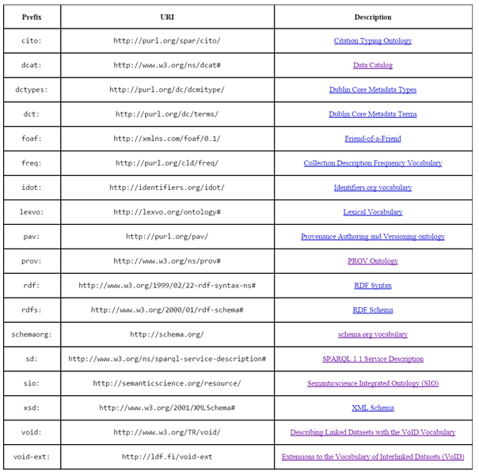

Slide 33
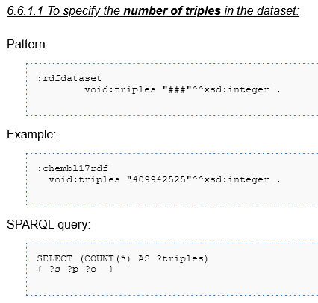
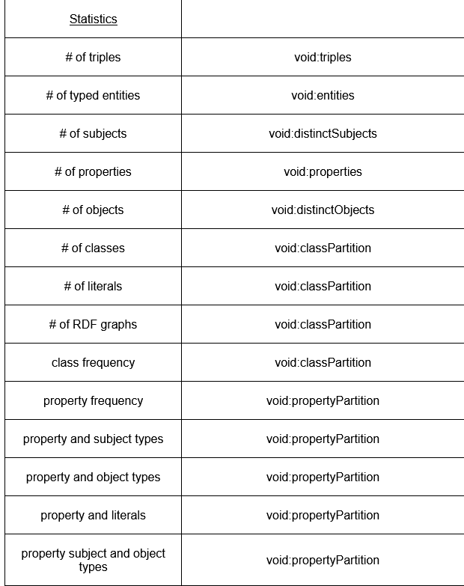
Statistics

Slide 34
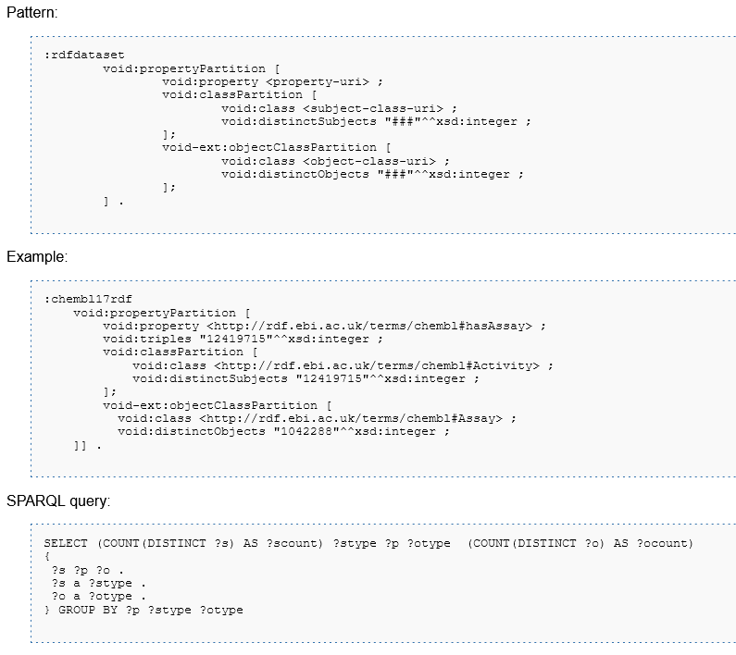
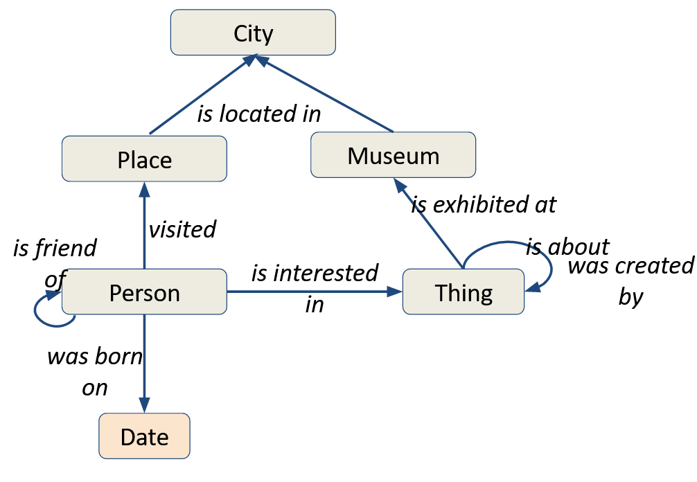
Metagraph

Slide 35
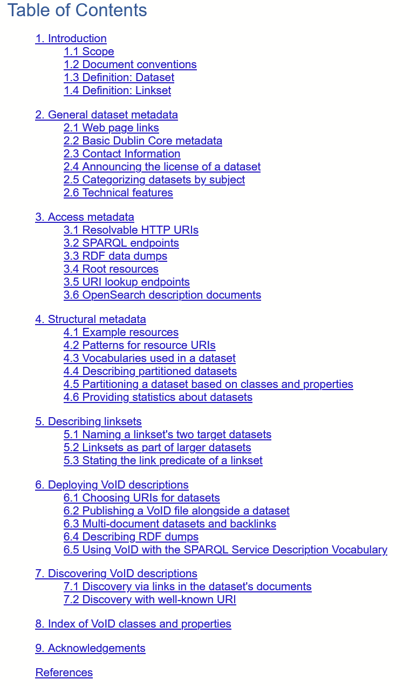
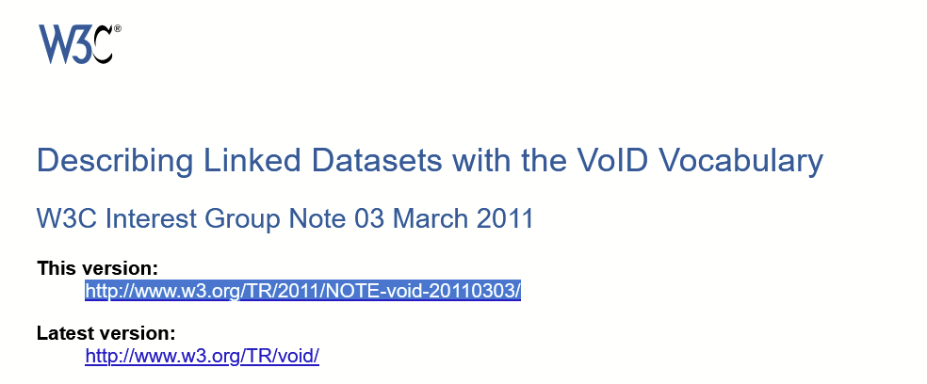
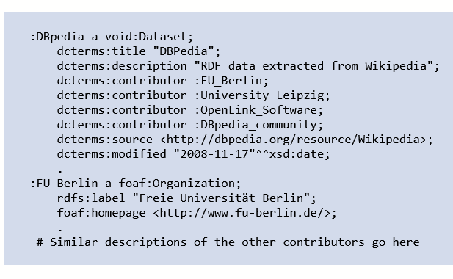

Slide 36
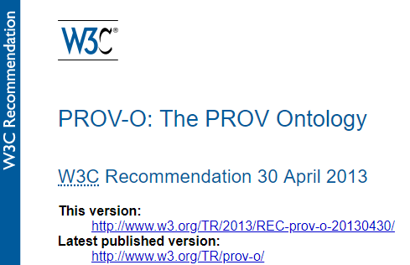

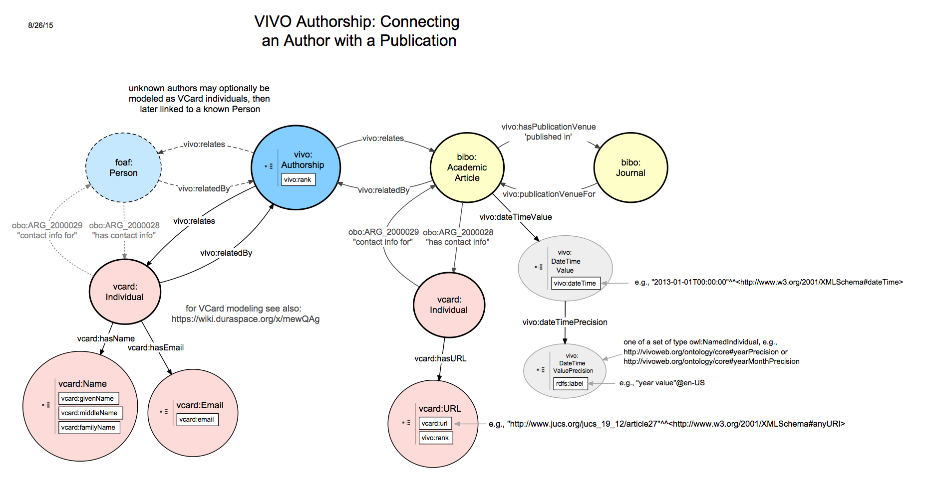
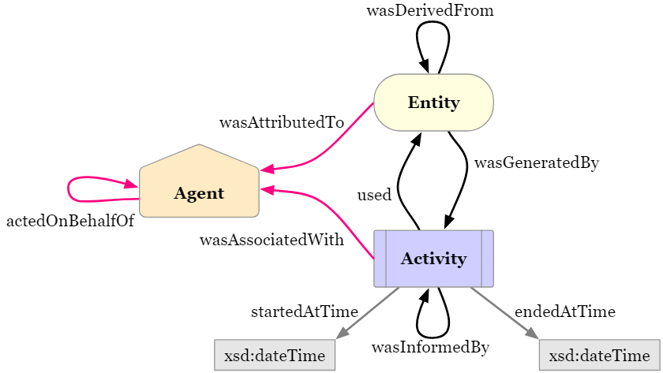

Slide 37

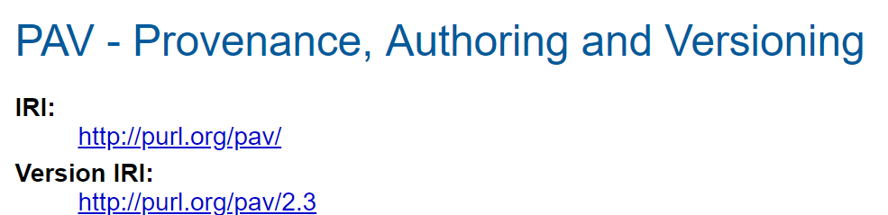
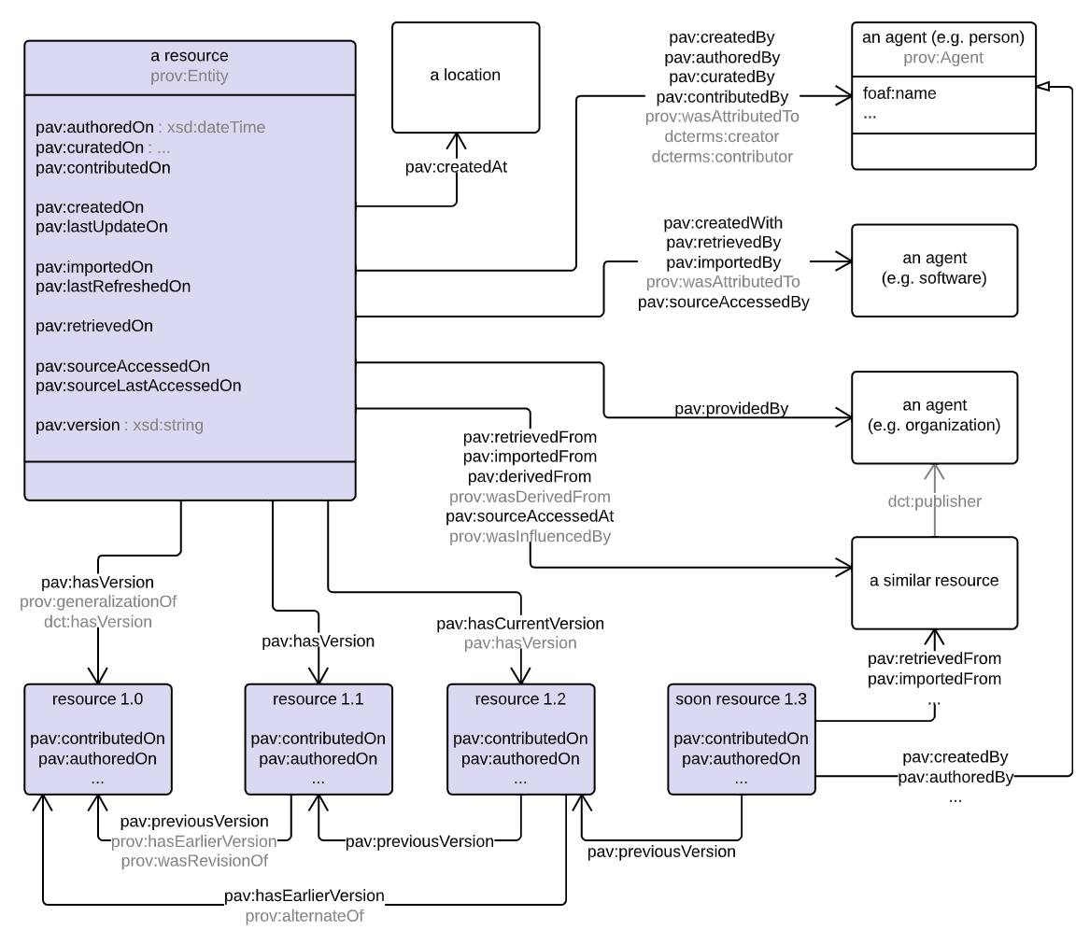
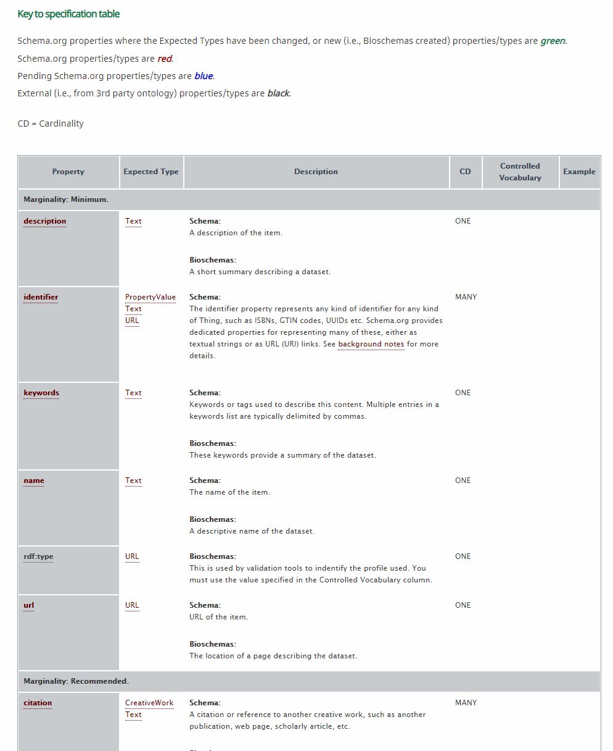
http://bioschemas.org
Notes:
PAV is a lightweight ontology for tracking Provenance, Authoring and Versioning. PAV specializes the W3C provenance ontology PROV-O in order to describe authorship, curation and digital creation of online resources
Bioschemas aims to improve the Findability on the Web of life sciences resources such as datasets, software, and training materials. It does this by encouraging people in the life sciences to use Schema.org markup in their websites so that they are indexable by search engines and other services. Bioschemas encourages the consistent use of markup to ease the consumption of the contained markup across many sites.

Slide 38
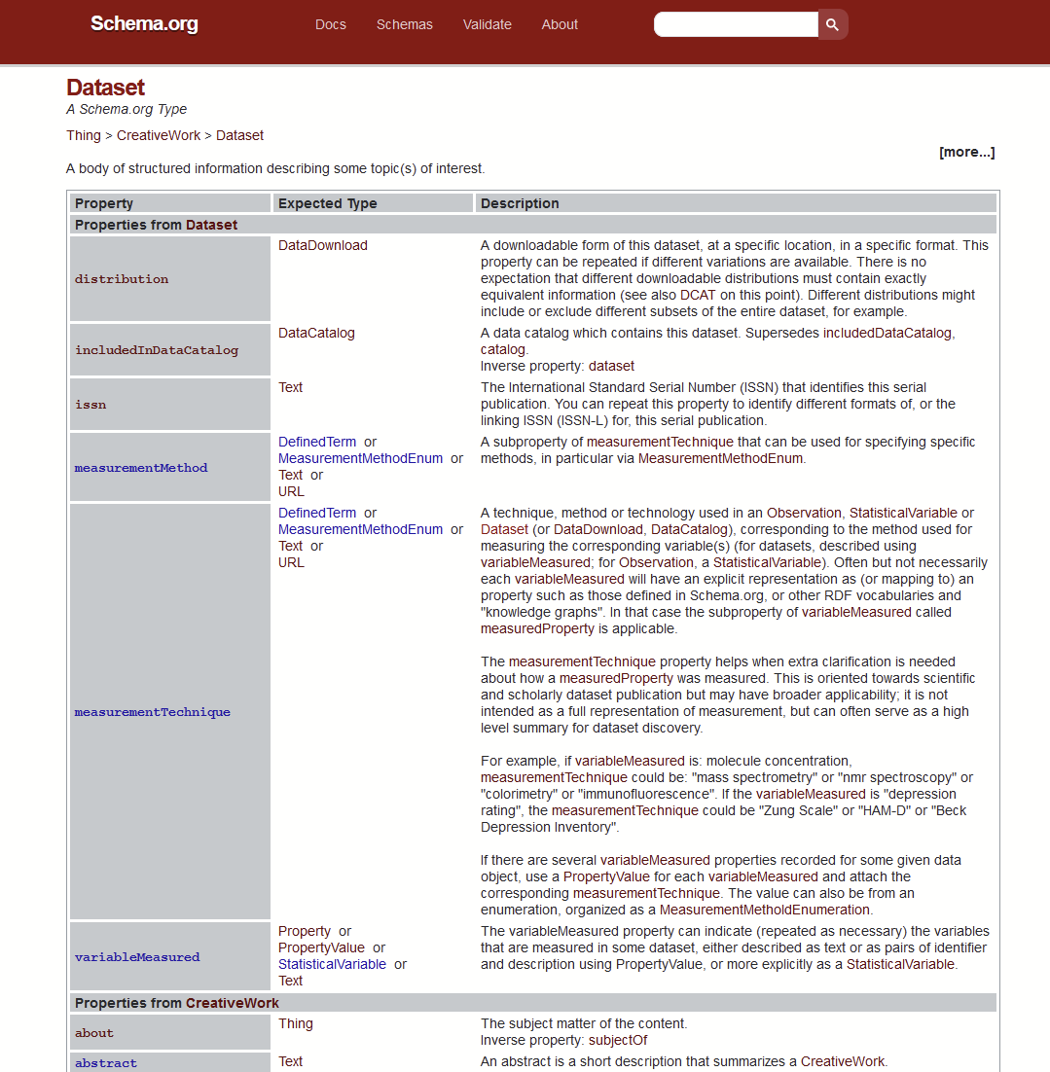

Slide 39

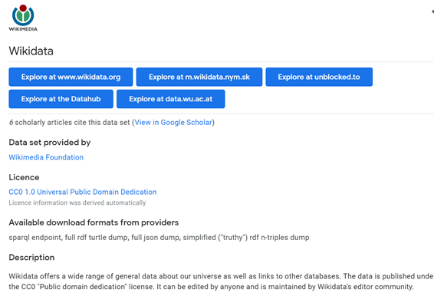
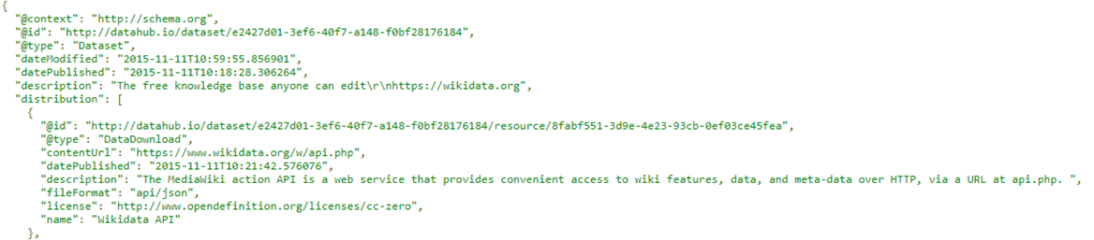

Slide 40
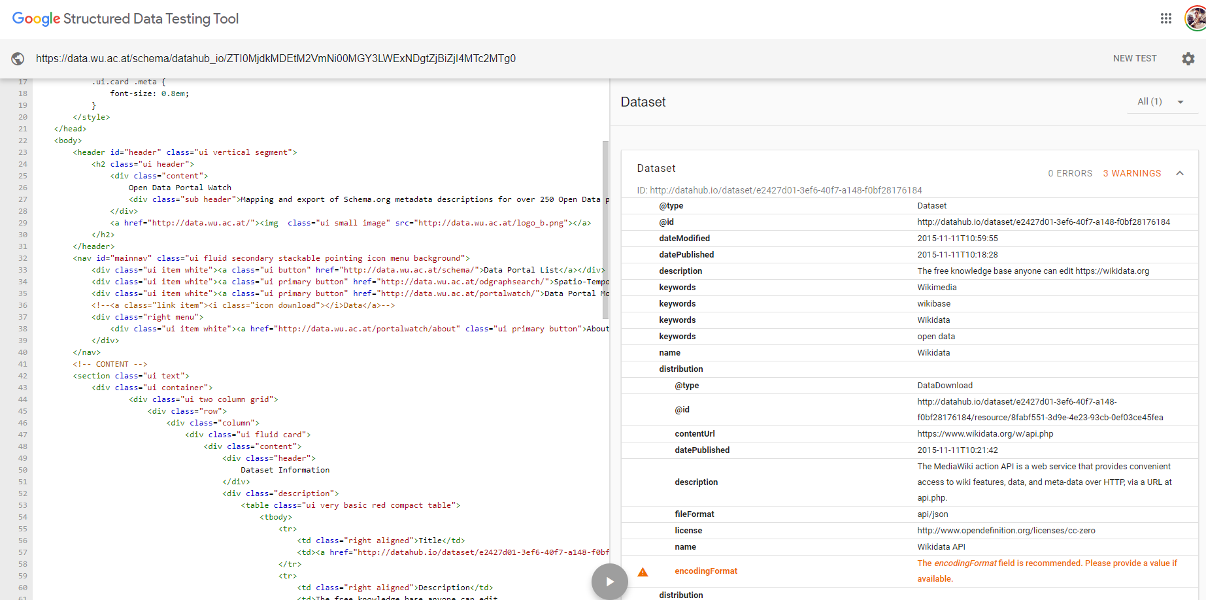

Slide 41
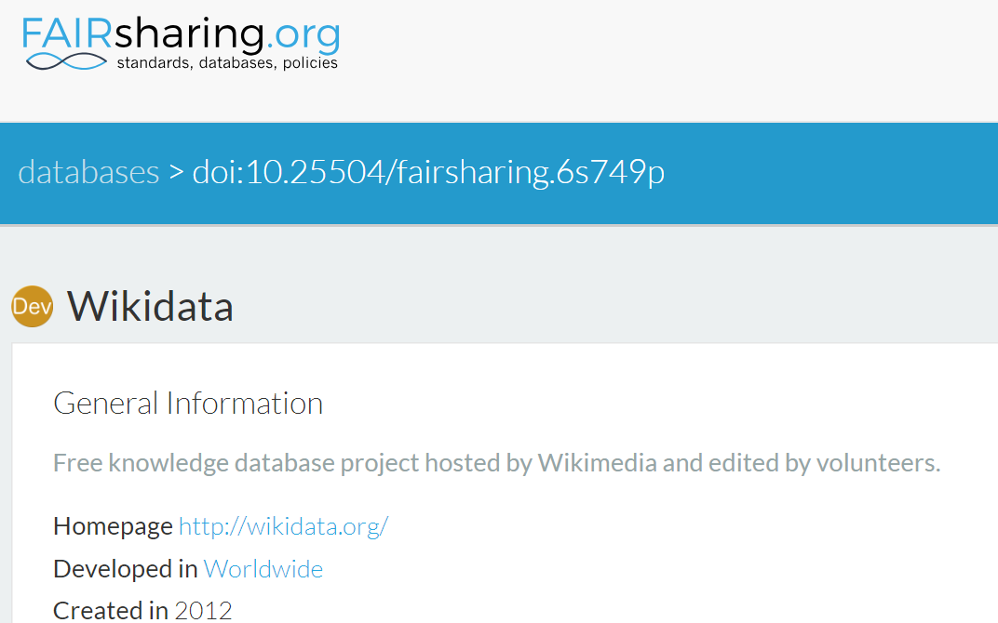
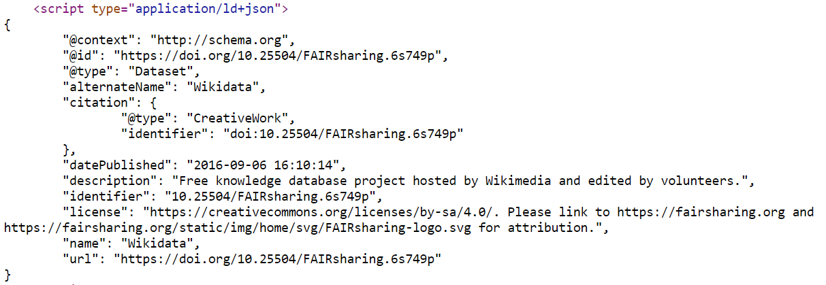
FAIRsharing is a repository of standards and databases. It exposes resource metadata using schema.org

Slide 42
Publishing RDF - Linked Data Principles
Use Uniform Resource Identifiers (URIs/URLs) as identifiers for things
Use HTTP URIs, so that people can look up those entities
When someone looks up a URI, provide useful information, using Semantic Web standards
Include links to other URIs, so that they can discover more things
Notes:
You could see the semantic web as a huge database using URLs as resources identifiers
URI are basically the same thing as URL
Uniform Resource Identifier / Uniform Resource Locators
There is also the concept of IRI now, which supports unicode characters such as mandarin or emojis:
International Resource Identifier

Slide 43
FAIR Knowledge Graphs
Build your knowledge graph using existing standards
Assign a unique identifier (URI) to every entity (kg, types, relations, instances)
Format the data using a data standard (e.g. RDF, nanopublications)
Capture the provenance and context of each assertion, and of the graph itself
Where possible, make links to other published resources
Create high quality metadata to document your KG
use metadata schemas (schema.org, HCLS)
add KG specific metadata (eg. number of triples, vocabs used, etc)
validate the metadata against the schema
Make your KG available to others
Version your KG, and publish the data and metadata to an archive
Create programmatic access points via APIs

Slide 44
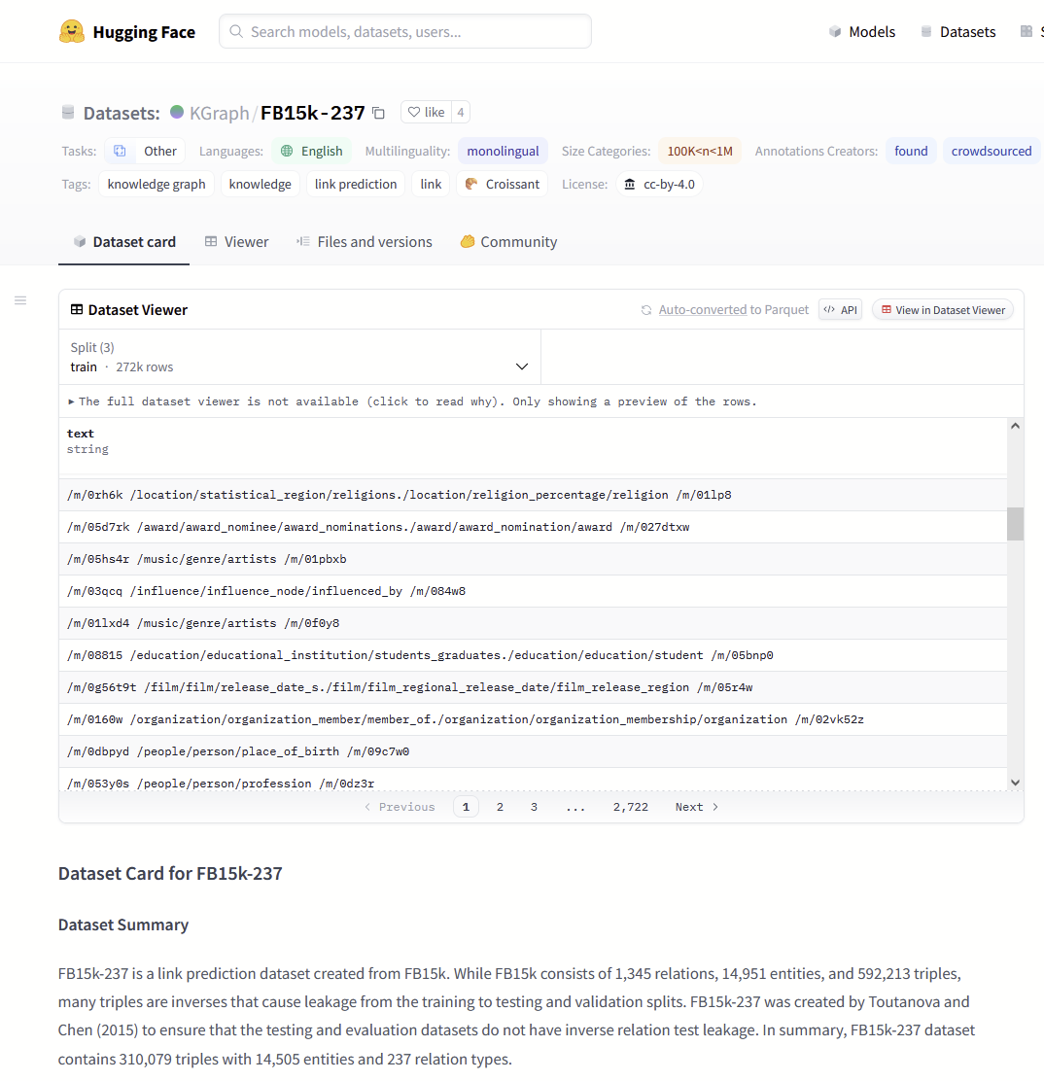
Publish to FAIR Repositories
Hugging Face publishes structured metadata and has APIs to access the content. Also can support large files through git LFS.

Slide 45
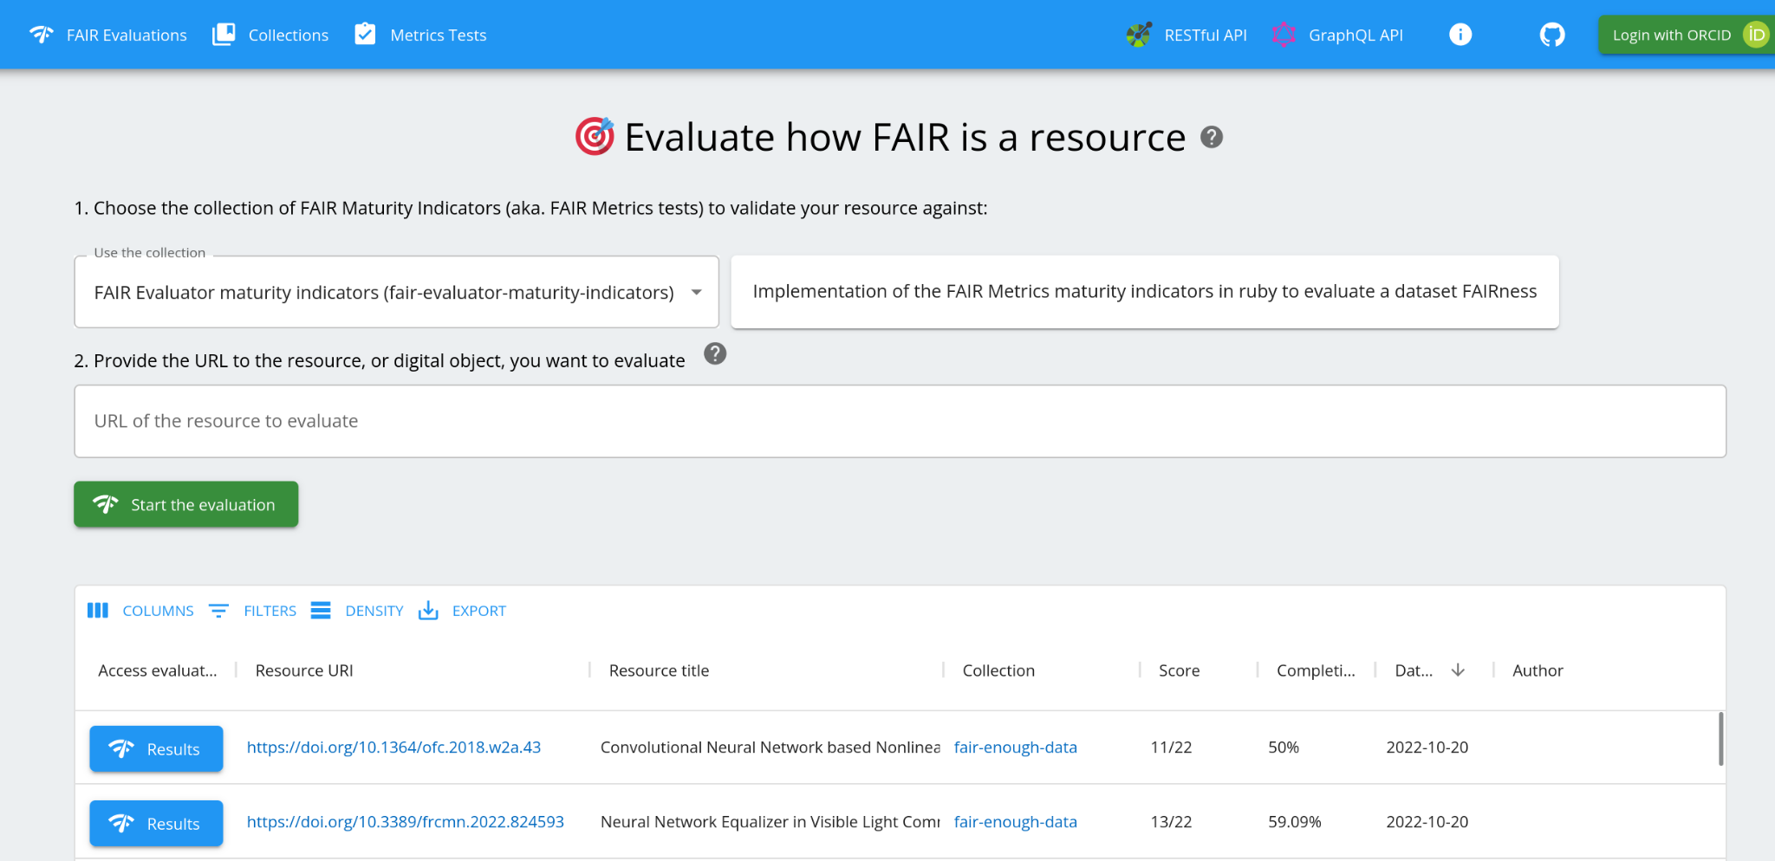
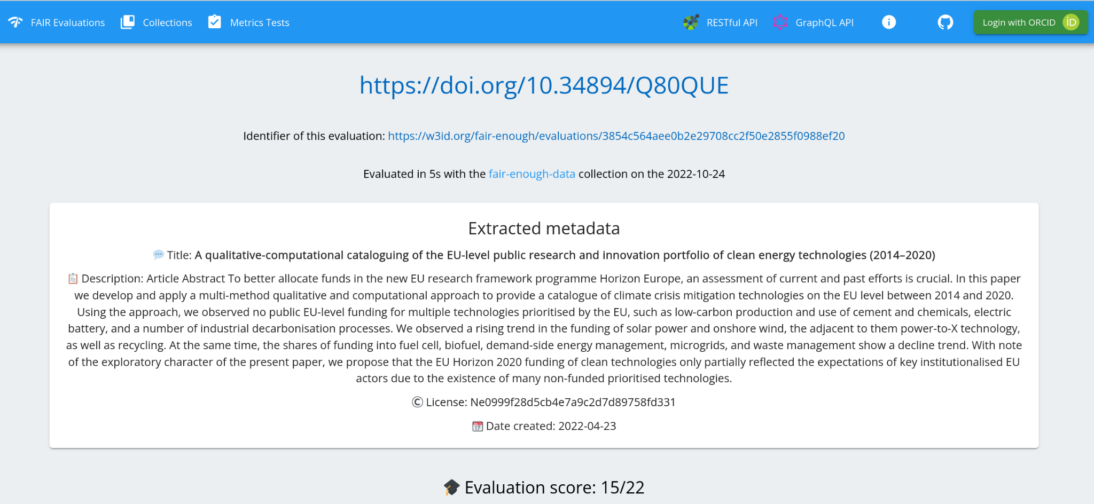
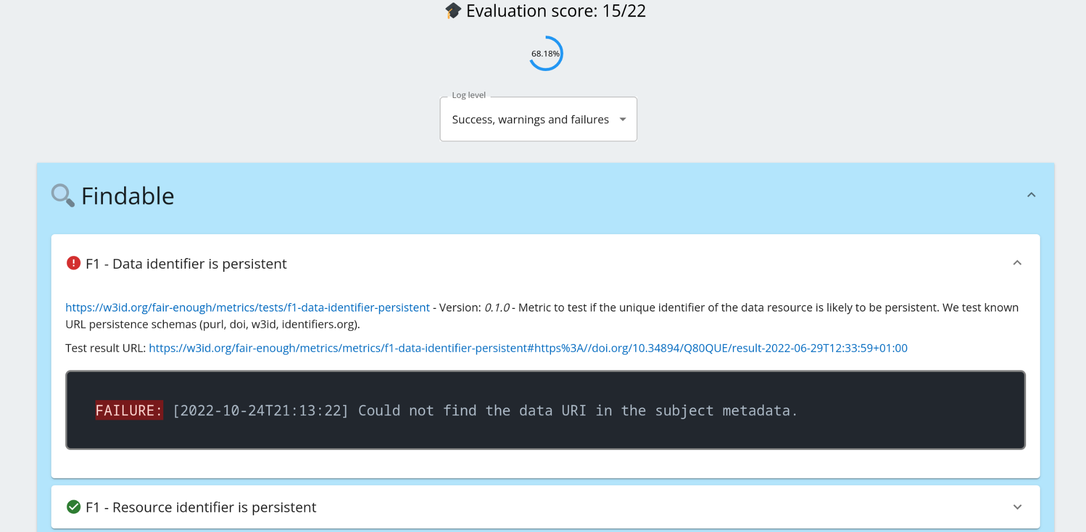
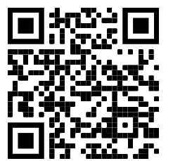
Quality of FAIR Implementation
FAIR Enough is a system to perform automated assessment of the technical quality of the FAIRness implementation.
FAST and can be used with different metric collections
Keeps track of past assessments to monitor status
Extensible via service based framework (can use FAIR Evaluator harvester and metrics)
Open source and Docker deployable
https://fair-enough.semanticscience.org

Slide 46
